Slide 1
House Ways & Means
Higher Ed Subcommittee
Budget Request, 2021-22

Slide 2
COVID-19 Update
The CHE has not received any Federal funds related to COVID-19.
The CHE is committed to Access, Affordability and Excellence.
As a coordinating agency, the CHE has facilitated virtual meetings among institutional leaders (presidents and chancellors, and academic, governmental relations, fiscal, and financial aid officers) to address COVID-19 related challenges and strategies to address the issues.
Improving affordability in the state’s higher education programs and services for students and families is especially critical during FY 21-22.
  The COVID-19 pandemic has impacted families’ employment status and their ability to support financially their students as they seek postsecondary education.
The CHE also seeks to encourage excellence in the higher education system.
  The CHE will pursue philanthropic opportunities to augment General Funds and other governmental funding.

Slide 3
Appropriations History
Notes:
Decrease in 2021 from 2020 relates to not receiving HEEEP and Carolina Cluster appropriations from FY 18-19 certified lottery surplus.

Slide 4
Recurring Request
The CHE has no recurring budget requests for FY 2021-22.

Slide 5
Non-Recurring Budget Requests
Request | Amount Requested | Description of Request
Need Based Grants | $8,000,000 | COVID-19 has impacted families’ employment status and their ability to support financially their students. BEA forecasts lottery funds to increase by $53 million.
PASCAL | $1,500,000 | The CHE is the fiscal agent for PASCAL, the Partnership Among South Carolina Academic Libraries. This request would maintain PASCAL at its current funding level. PASCAL leverages academic library resources and needs to renew multiyear eBook subscription licenses, provide system vendor software and increase access and affordability of instructional resources for students.

Slide 6
Capital Request
The CHE has no capital budget request for FY 2021-22.

Slide 7
Other Fund Request
The CHE has no “other fund” requests for FY 2021-22.

Slide 8
Federal Fund Request
The CHE has no federal fund requests for FY 2021-22.

Slide 9
FTE Request
The CHE has no FTE requests for FY 2021-22.

Slide 10
FY 2019-20 Provisos (page 1 of 5)
Proviso Number | Title | Description | Recommendation
11.1 | Contract for Services Program Fees | Funds appropriated for Southern Regional Education Board Contract Programs and Dues | Keep
11.2 | African American Loan program | Fund distribution for loan program to attract African American males to teaching professions | Keep
11.3 | GEAR-UP | Funds shall be used for state grants programs to reach disadvantaged middle school students to improve college readiness | Keep
11.4 | EPSCoR Committee Representation | State EPSCoR Committee shall have an executive committee including representation from a research and a four-year teaching institution | Keep
11.5 | SREB Funds Exempt from Budget Cut | Funds appropriated to the CHE for SREB programs shall be excluded from any across the board mandated cut | Keep

Slide 11
FY 2019-20 Provisos (page 2 of 5)
Proviso Number | Title | Description | Recommendation
11.6 | Performance Improvement Pool Allocation | 80% of funds appropriated under Performance Funding will be allocated to EPSCoR and 20% to support SC State’s management ed programs | Keep
11.7 | Troop-to-Teachers | Members of armed forces who are admitted to program are entitled to pay in-state tuition at participating state schools | Keep
11.8 | Need-Based Foster Youth Grants | Youth in custody of DSS and attending higher education school in the state are eligible for additional need-based funding of $2,000-2,500 | Keep
11.9 | Tuition Age | Age limitation of children of war veterans admitted to attend free is suspended if they successfully appeal due to extenuating health condition | Keep
11.6 | Performance Improvement Pool Allocation | 80% of funds appropriated under Performance Funding will be allocated to EPSCoR and 20% to support SC State’s management ed programs | Keep

Slide 12
FY 2019-20 Provisos (page 3 of 5)
Proviso Number | Title | Description | Recommendation
11.10 | LIFE & Palmetto Fellows Enhancement Stipends | Requires student certification and institution verification the student is meeting all requirements to be enrolled as a declared major. | Keep
11.11 | SmartState | The CHE is prohibited from expending any source of marketing funds on SmartState | Keep
11.12 | College Transition Need-Based Grants | No more than $350,000 of need-based grants shall be used to provide grants to students enrolled in a college transition program serving students with intellectual disabilities | Keep
11.13 | Scholarship Awards | A student may receive a Palmetto Fellows or LIFE award during the summer requiring full-time enrollment of at least 12 hours over the summer. | Keep

Slide 13
FY 2019-20 Provisos (page 4 of 5)
Proviso Number | Title | Description | Recommendation
11.14 | Other Funded FTE Revenue | When institutions request additional other funded FTE positions, the EBO shall inform CHE of its decision | Keep
11.15 | Abatements | Institutions must submit to the CHE the total number of out-of-state undergraduate students during the prior fiscal year who received rate abatements | Keep
11.16 | Outstanding Institutional Debt | Institutions must submit data on all outstanding institutional debt to Senate Finance, HWM and the CHE | Keep
11.17 | Longitudinal Data Reports | The CHE is directed to report on tuition and required fee trends, and comparable data among SREB states | Keep

Slide 14
FY 2019-20 Provisos (page 5 of 5)
Proviso Number | Title | Description | Recommendation
11.18 | Suspend Governor’s Professor of the Year Award | The award shall be suspended for FY 2019-20 | Keep
11.19 | Prohibition of Discriminatory Practices | The CHE shall print and distribute to all public institutions the definition of anti-Semitism | Keep
3.5 | LEA: FY 2019‑20 Lottery Funding) | Provides allocations and specific authorization for the expenditure of state lottery funds. | Modify

Slide 15
Background – Request to Modify Proviso
The CHE has administrative oversight of state scholarship and grants programs including Palmetto Fellows, LIFE, and S.C. HOPE Scholarships, the S.C. Need-Based Grant Program and Lottery Tuition Assistance.
Administrative responsibilities for these programs are assigned to three professional staff (3 FTEs), one scholarship auditor (1 FTE) and one program assistant (1 FTE).
Since 2017 administrative responsibilities and constituent services (constituent calls, financial aid assistance, workshops, parent nights, etc.) to students, school districts and higher institutions have significantly increased as families become aware of financial assistance available to S.C. residents.
In the fall of 2019, the CHE served over 111,000 students including:
  9,123 Palmetto Fellows,
  41,633LIFE Scholarship recipients,
  3,570 S.C. HOPE Scholarship recipients,
  27,379 S.C. Need-based Grant recipients and
  29,671Lottery Tuition Assistance recipients.

Slide 16
Request to Modify Proviso
Proviso Number | Title | Description | Recommendation
3.5 | LEA: FY 2019‑20 Lottery Funding) | Provides allocations and specific authorization for the expenditure of state lottery funds. | Modify
Due to the increase in the CHE’s student-focused activities (such as College & Career Decision Day, FAFSA completion events, virtual college fairs), and a focus on program accountability and monitoring, the CHE suggests the following modification to Proviso 3.5:
“The Commission on Higher Education is authorized to use up to $345,000 400,000 of the funds appropriated in this provision for LIFE, HOPE, and Palmetto Fellows scholarships to provide the necessary level of program support for the scholarship award process and to provide for a Scholarship Compliance Auditor.”

Slide 17
Employees (page 1 of 3)
Overview by Employee Group
 | Total Authorized | Filled | Vacant
Classified | 43 | 29 | 14
Temporary | 32 | 13 | 19
Total | 76 | 43 | 33

Slide 18
Employees (page 2 of 3)
Agency Leadership by Ethnic Origin

Slide 19
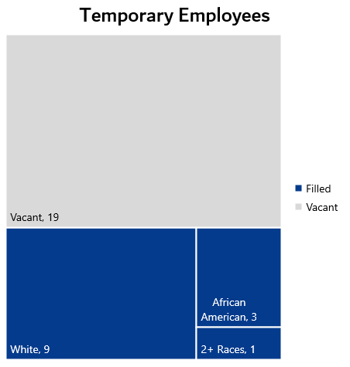
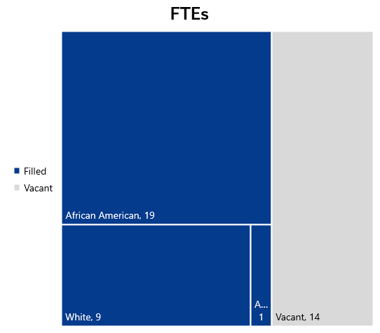
Employees (page 3 of 3)
Agency Positions by Ethnic Origin

Slide 20
Contact Information
Rusty Monhollon, PhD
President & Executive Director
  (803) 737-2155
  rmonhollon@che.sc.gov

